Slide 1
Lecture Title
Course Code:
Course Title:
Dept. of Computer Science
Faculty of Science and Technology
Lecturer No: | 1(c) | Week No: | 3 | Semester:
Lecturer: | Md. Siyamul Islam Siyamul@aiub.edu

Slide 2
Lecture Outline
Learn Syntax
Variable declarations
Introduction of basic data movement
Program organization: Code, Data and stack

Slide 3

Instructions: XCHG
MOV is used to exchange the contents between two registers or register and memory-location.
Syntax: XCHG destination, source
XCHG AH, BL
[reads exchange value of AH with BL]

Slide 4
Instructions: ADD
ADD is used to add content of two registers, register and memory-location or add a number to register or memory location.
Syntax: ADD destination, source
ADD WORD1,AX [reads Add AX to WORD1]

Slide 5
Instructions: SUB
SUB is used to subtract content of two registers, register and memory-location or subtract a number from register or memory location.
Syntax: SUB destination, source
SUB AX,DX [reads Subtract DX from AX]

Slide 6
Instructions: INC
INC is used to add 1 to the contents of a register or memory-location.
Syntax: INC destination
INC WORD1 [reads Add 1 to WORD1]

Slide 7
Instructions: DEC
DEC is used to subtract 1 from the contents of a register or memory-location.
Syntax: DEC destination
DEC WORD1 [reads subtract 1 from WORD1]

Slide 8
Instructions: NEG
NEG is used to negate the contents of the destination
NEG does this by replacing the contents by its two’s complement.
Syntax: NEG destination
NEG BX [reads negate the contents of BX]

Slide 9
Agreement of Operator
The operand of the preceding two-operand instruction MUST be same type. (i.e. both bytes or words). Thus,
MOV AX,BYTE1 ; its illegal
MOV AH,’A’ ; legal
MOV AX,’A’ ; legal if source is a word

Slide 10
Program Structure
A program Consist of
Stack
Data
Code
Each part occupies memory segments
Program segment is translated into memory segment by assembler.
The size of code and data of a program can be specified by memory model using .MODEL directive
.MODEL Memory_model
.MODEL SMALL [Code in ONE segment and Data in one segment]

Slide 11
Stack Segment
Allocate a block of memory (stack area) to store the stack.
The stack area should be big enough to contain the stack at its maximum size.
Declaration:
.STACK size
.STACK 100H
** Allocates 100 bytes for stack area reasonable size for most applications
** If size is omitted 1KB is allocated for stack area.

Slide 12
Data Segment
Contains all the variable definitions and sometimes Constant definitions (constant does not take any memory).
To declare data segment .DATA directive is used followed by variable and constant declaration.
.DATA
WORD1 DW 2
BYTE1 DB 1
MSG DB ‘THIS IS A MESSAGE’
MASK EQU 10010001B

Slide 13
Code Segment
Contains the program’s instructions
Declaration:
.CODE name [name is optional]
There is no need of name in SMALL program
Inside a code segment, instructions are organized as procedures.
name PROC
; body of the procedure
name ENDP
Here name = name of the procedure. PROC and ENDP are pseudo-ops

Slide 14
Program Structure
.MODEL SMALL
.STACK 100H
.DATA
; data definitions here
. CODE
MAIN PROC
;instructions go here
MAIN ENDP
;other procedures go here
END MAIN
*** The last line of the program should be the END directive, followed by the name of main procedure

Slide 15
Instruction: LEA
LEA: Load Effective address
LEA destination, source
LEA puts copy of the source offset address into the destination.
i.e. LEA DX, MSG ; will load address of MSG to DX

Slide 16
Program Segment Prefix (PSP)
PSP contains information about the program to facilitate the program access in this area
DOS places its segment number in both DS and ES before program execution
Usually, DS does not contain the segment number of the data segment.
Thus, a program with data segment will start with these two instruction
MOV AX,@DATA [name of data segment define in .DATA]
MOV DS,AX

Slide 17
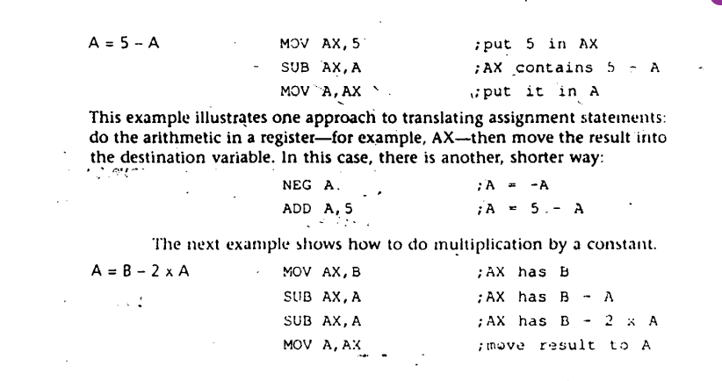

Slide 18
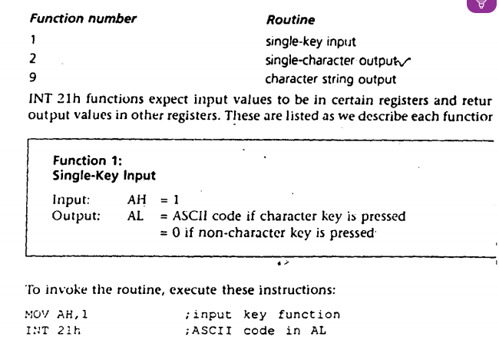

Slide 19
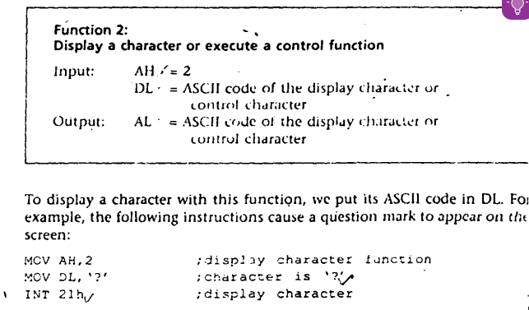

Slide 20
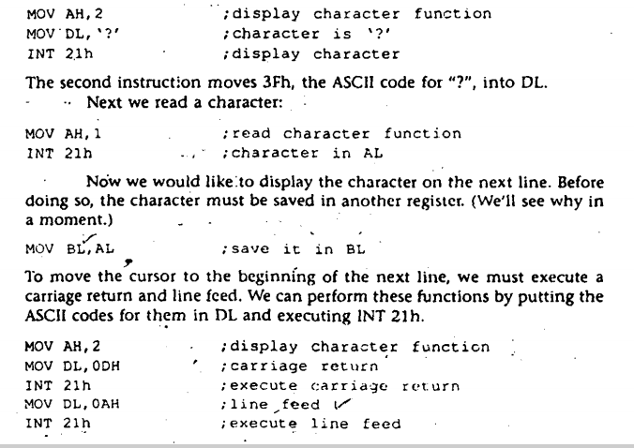

Slide 21
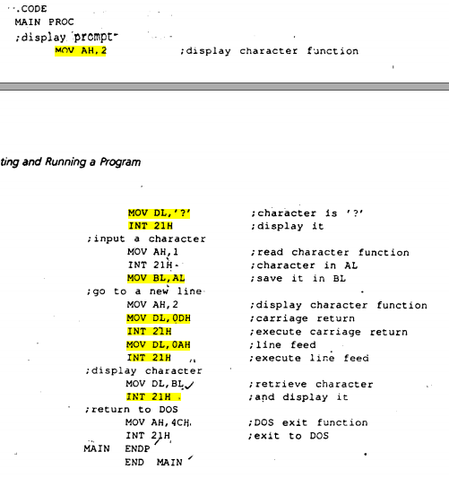

Slide 22
References
Assembly Language Programming and Organization of the IBM PC, Ytha Yu and Charles Marut, McGraw Hill, 1992. (ISBN: 0-07-072692-2).
https://www.tutorialspoint.com/assembly_programming/index.htm

Slide 23
Books
Assembly Language Programming and Organization of the IBM PC, Ytha Yu and Charles Marut, McGraw Hill, 1992. (ISBN: 0-07-072692-2).
Essentials of Computer Organization and Architecture, (Third Edition), Linda Null and Julia Lobur
W. Stallings, “Computer Organization and Architecture: Designing for performance”, 67h Edition, Prentice Hall of India, 2003, ISBN 81 – 203 – 2962 – 7
Computer Organization and Architecture by John P. Haynes.

